Slide 1


Slide 2
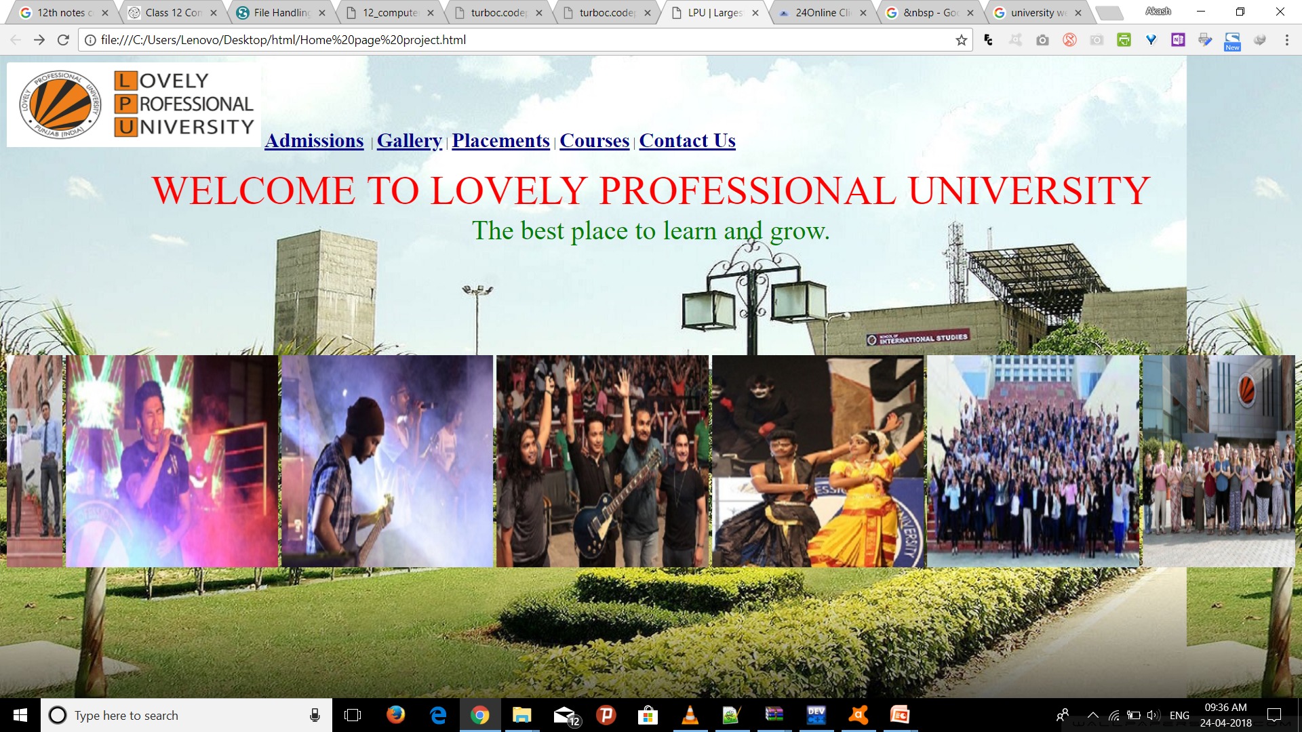

CSE326
University Website
Submitted by:
Akash Kumar
V Tarun raj
V Hema latha
Submitted to:
Dr. Gokulnath K.
Assistant professor
Notes:
To use this title animation slide with a new image simply 1) move the top semi-transparent shape to the side, 2) delete placeholder image, 3) click on the picture icon to add a new picture, 4) Move semi-transparent shape back to original position, 5) Update text on slide.

Slide 3

Home Page
Admissions
Gallery
Courses
Placements
Contact Us
Contents
Notes:
To use this title animation slide with a new image simply 1) move the top semi-transparent shape to the side, 2) delete placeholder image, 3) click on the picture icon to add a new picture, 4) Move semi-transparent shape back to original position, 5) Update text on slide.

Slide 4
Technologies Used
Html - The layout structure of the website has been created in HTML
CSS - The entire styling is handled by the CSS.
Javascript - The entire styling is handled by the CSS.
Notes:
To use this title animation slide with a new image simply 1) move the top semi-transparent shape to the side, 2) delete placeholder image, 3) click on the picture icon to add a new picture, 4) Move semi-transparent shape back to original position, 5) Update text on slide.

Slide 5
Aim
The purpose of this source is to be describe the university website which provides the information about the university.
The minimum requirement of GUI as follows:
• Home page
• Courses
• Admissions
• Gallery
• Placement
• Contact us
Notes:
To use this title animation slide with a new image simply 1) move the top semi-transparent shape to the side, 2) delete placeholder image, 3) click on the picture icon to add a new picture, 4) Move semi-transparent shape back to original position, 5) Update text on slide.

Slide 6
Modules available
The work areas of the project have been divided among a team of three members in our group.
One working on the templating of the website while the other designing the look and feel of
the of entire project as it progresses.
The layout and styling of the website is being dealt by V tarun raj ,
Akash kumar, V Hema latha are working on improving the UI and UX, tweaking the
Javascript. Every one of us is working individually on the project and
we regularly merge the project tweaks to progress with the agreed changes.
Notes:
To use this title animation slide with a new image simply 1) move the top semi-transparent shape to the side, 2) delete placeholder image, 3) click on the picture icon to add a new picture, 4) Move semi-transparent shape back to original position, 5) Update text on slide.

Slide 7
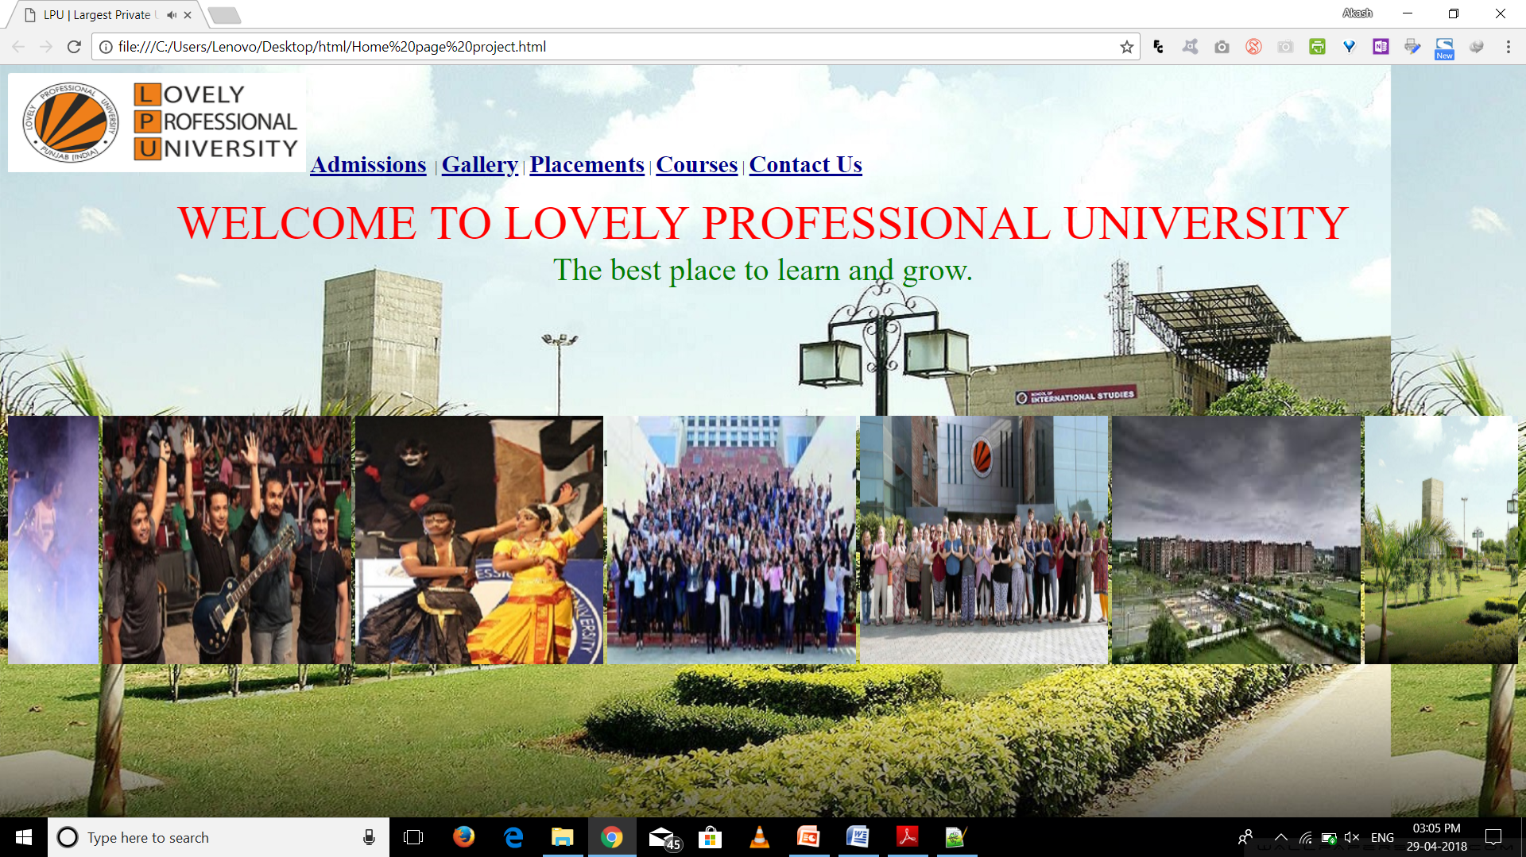
Notes:
To use this title animation slide with a new image simply 1) move the top semi-transparent shape to the side, 2) delete placeholder image, 3) click on the picture icon to add a new picture, 4) Move semi-transparent shape back to original position, 5) Update text on slide.

Slide 8
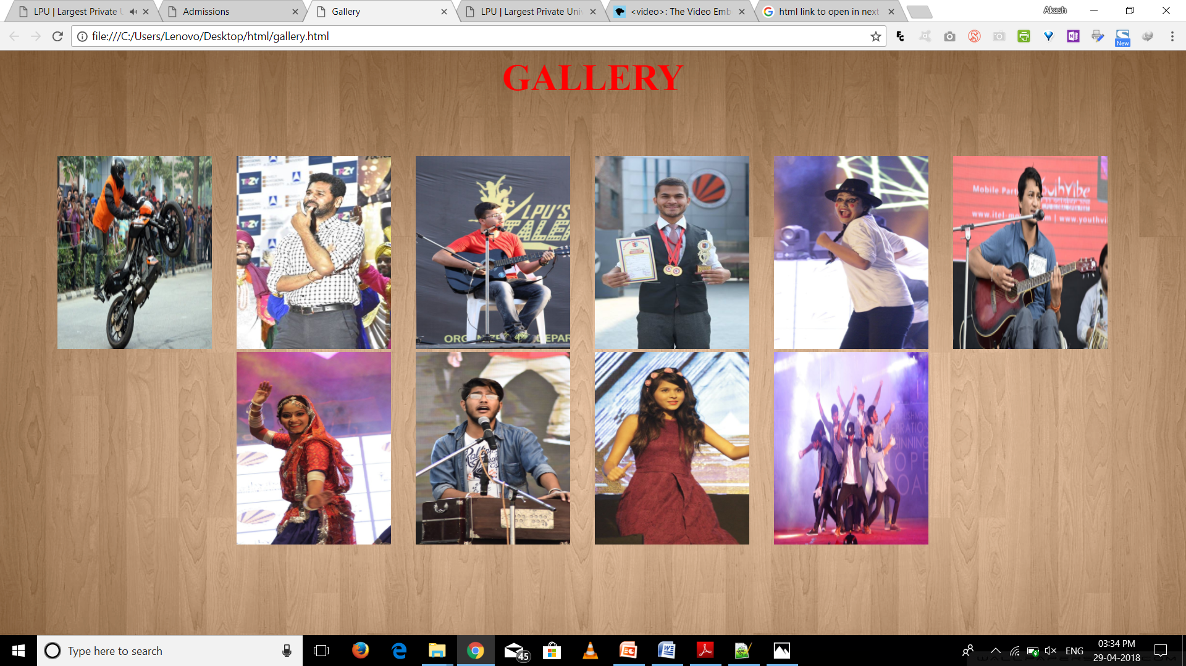
Notes:
To use this title animation slide with a new image simply 1) move the top semi-transparent shape to the side, 2) delete placeholder image, 3) click on the picture icon to add a new picture, 4) Move semi-transparent shape back to original position, 5) Update text on slide.

Slide 9
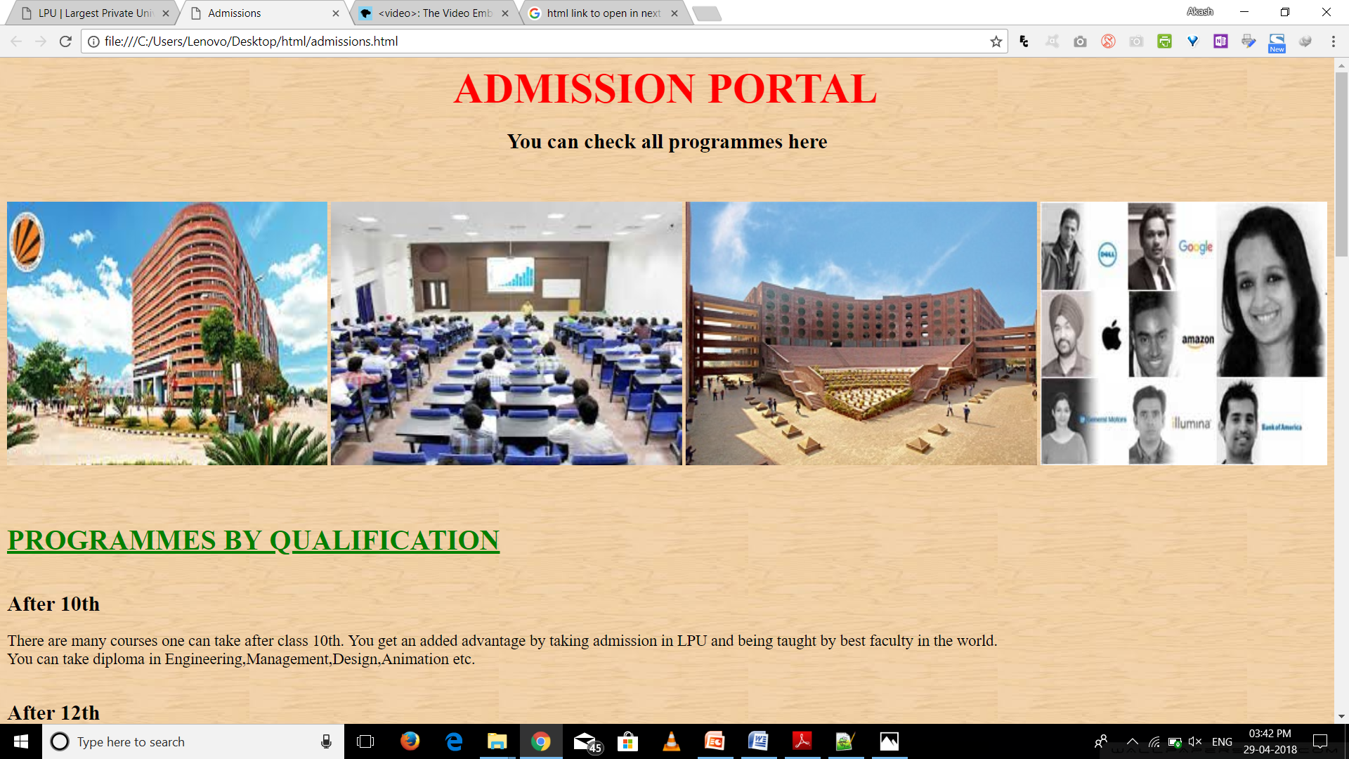
Notes:
To use this title animation slide with a new image simply 1) move the top semi-transparent shape to the side, 2) delete placeholder image, 3) click on the picture icon to add a new picture, 4) Move semi-transparent shape back to original position, 5) Update text on slide.

Slide 10
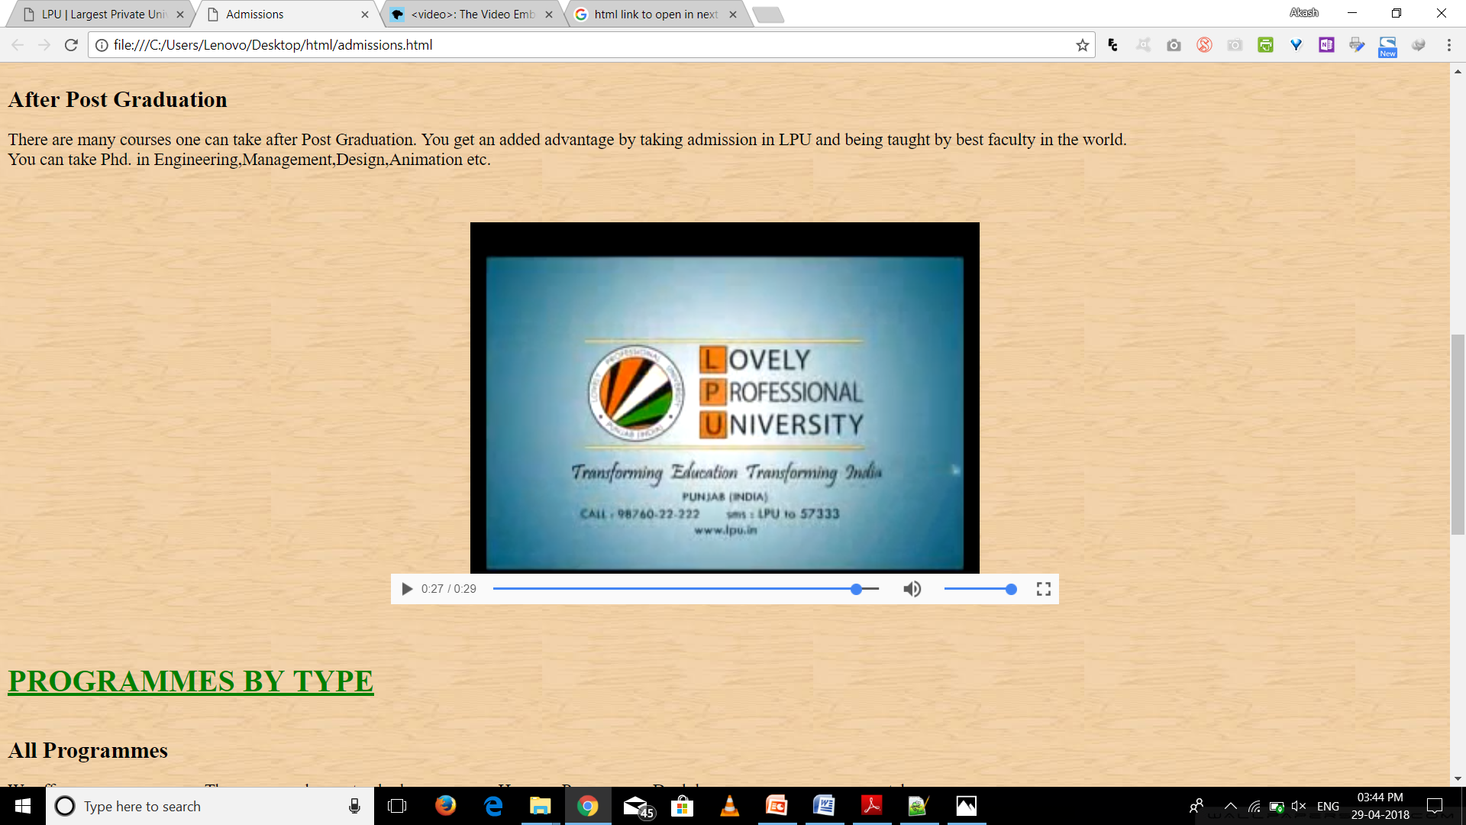
Notes:
To use this title animation slide with a new image simply 1) move the top semi-transparent shape to the side, 2) delete placeholder image, 3) click on the picture icon to add a new picture, 4) Move semi-transparent shape back to original position, 5) Update text on slide.

Slide 11
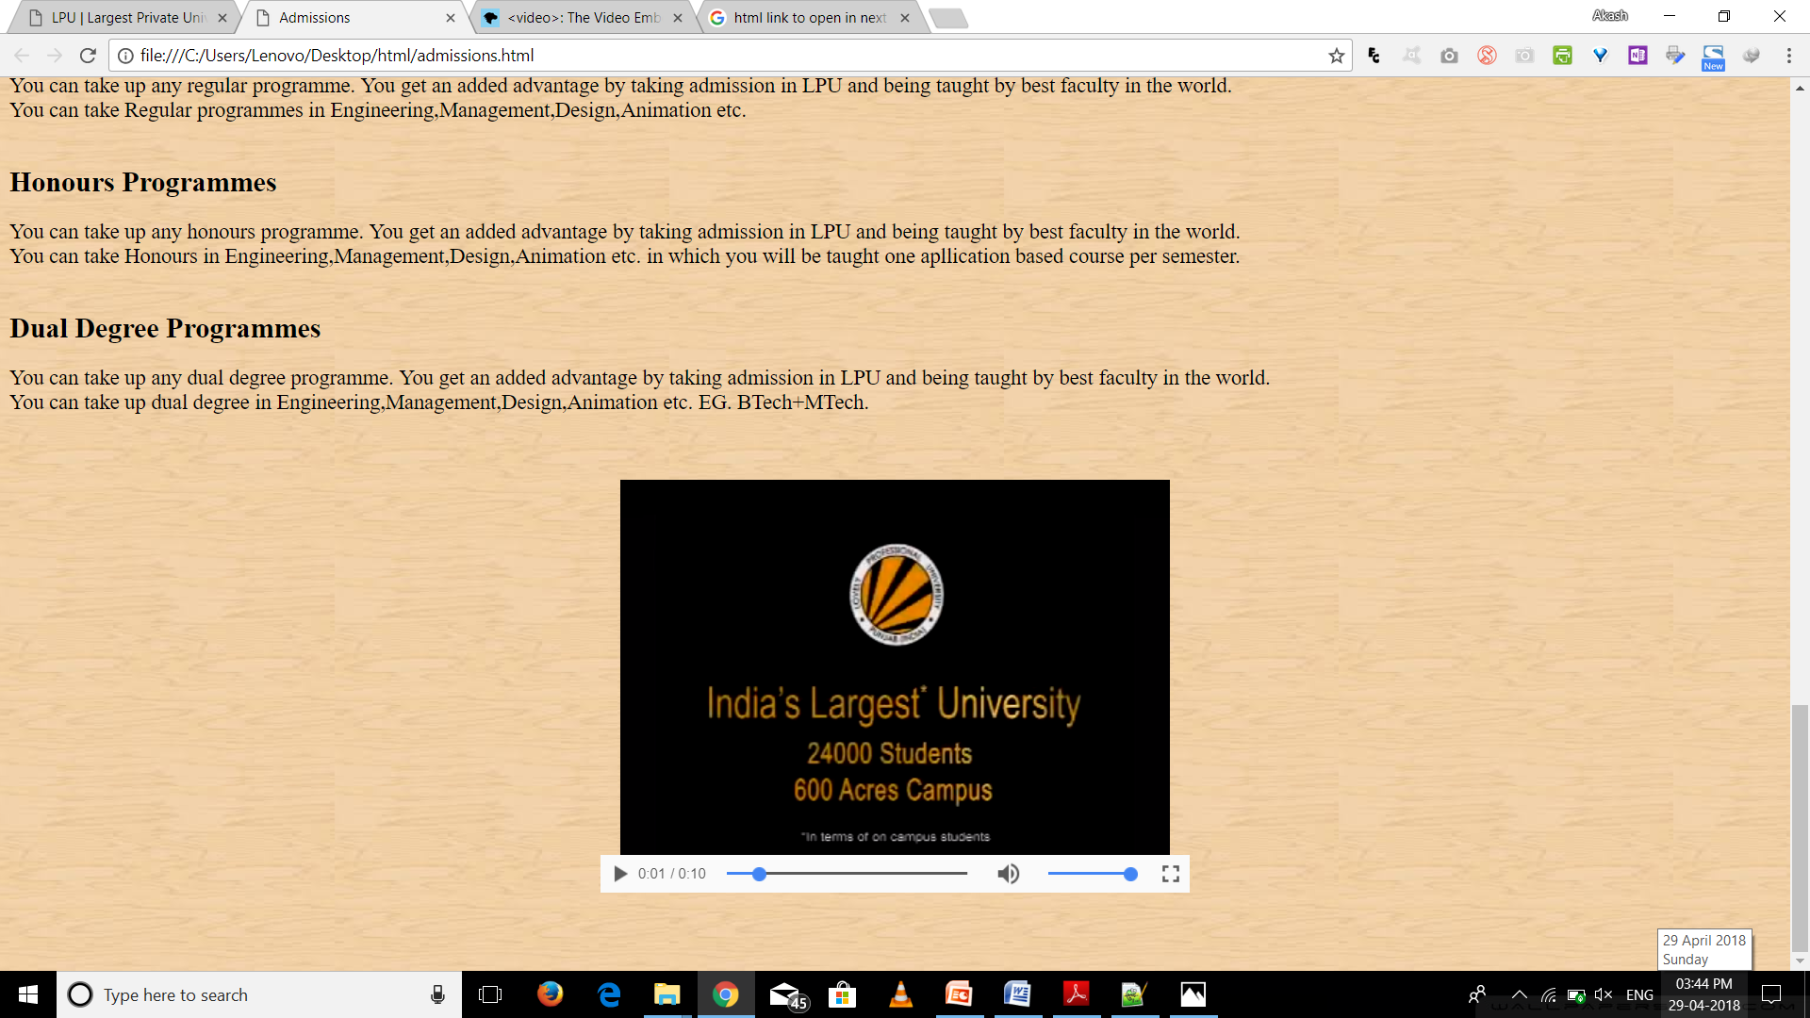
Notes:
To use this title animation slide with a new image simply 1) move the top semi-transparent shape to the side, 2) delete placeholder image, 3) click on the picture icon to add a new picture, 4) Move semi-transparent shape back to original position, 5) Update text on slide.

Slide 12
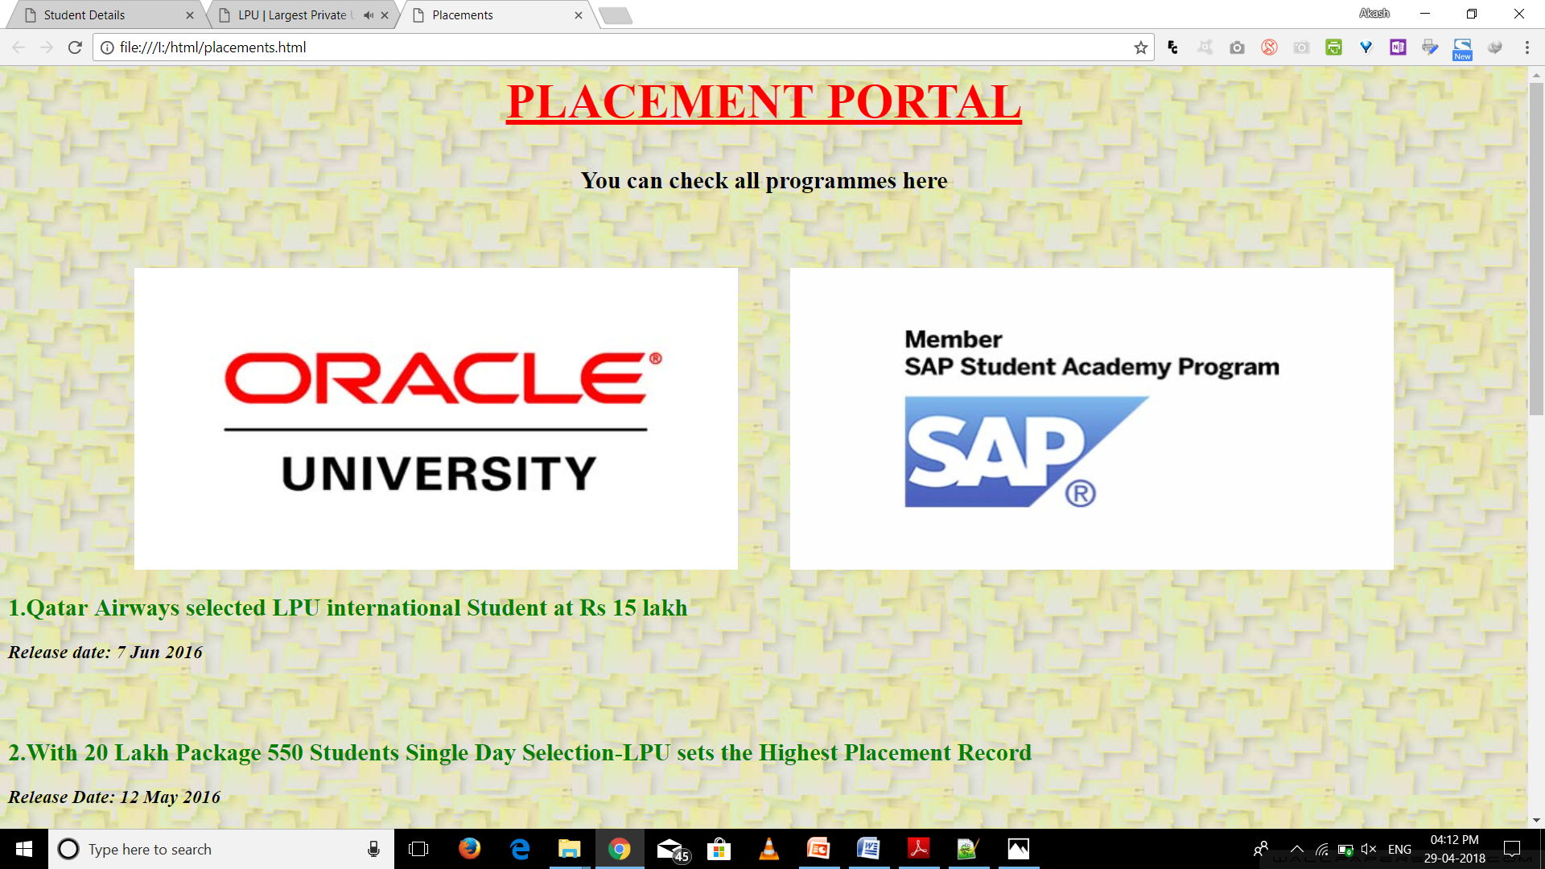
Notes:
To use this title animation slide with a new image simply 1) move the top semi-transparent shape to the side, 2) delete placeholder image, 3) click on the picture icon to add a new picture, 4) Move semi-transparent shape back to original position, 5) Update text on slide.

Slide 13

Notes:
To use this title animation slide with a new image simply 1) move the top semi-transparent shape to the side, 2) delete placeholder image, 3) click on the picture icon to add a new picture, 4) Move semi-transparent shape back to original position, 5) Update text on slide.

